Slide 1

Bangaliana Fashion Limited
Name: Md. Sujon
Batch: 61
Department: Mass Communication and Journalism
Date: 29/01/2025

Slide 2
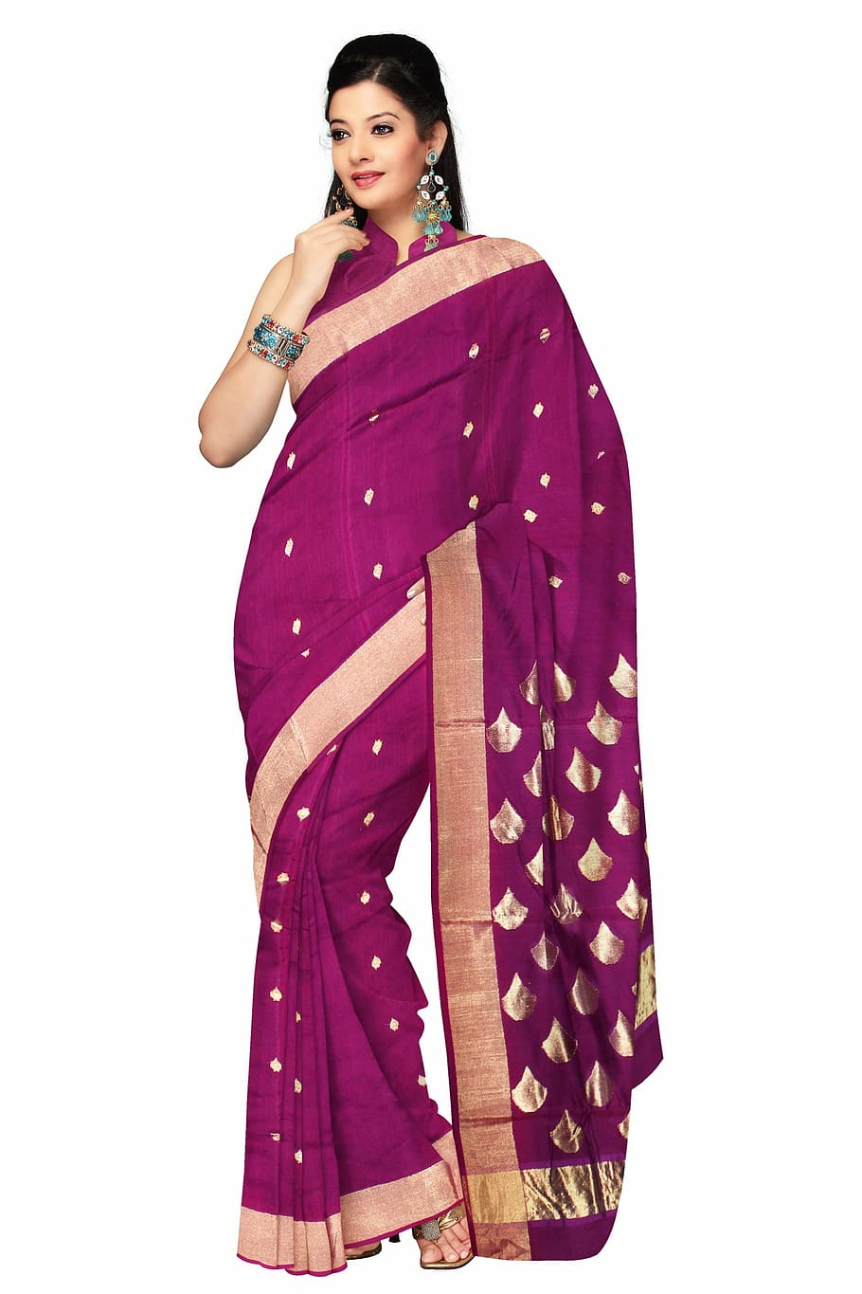
Summary of Bangaliana Fashion Ltd
Bangaliana Fashion Limited is a leading fashion brand that blends traditional Bangladeshi heritage with modern trends.
The company specializes in ethnic and contemporary apparel, offering a wide range of clothing and accessories that celebrate cultural elegance.

Slide 3
Key Highlight of this company
Products & Services: Traditional & contemporary clothing, custom tailoring, fashion accessories, and both online & offline retail experiences.
Market Position: Strong presence in the ethnic fashion industry with a growing e-commerce sector.
Competitive Edge: Sustainable fashion initiatives, high-quality craftsmanship, and affordable pricing.
Future Outlook: Expanding globally by embracing modern fashion trends while staying rooted in cultural traditions.

Slide 4
Products of bangaliana Fashion Ltd
Bangaliana Fashion Limited offers a diverse range of fashion products that blend traditional Bangladeshi styles with modern trends.
Traditional & Ethnic Wear
Sarees (Jamdani, Muslin, Silk, Cotton)
Salwar Kameez & Kurtis
Panjabi & Sherwani for men
Traditional Handwoven Fabrics

Slide 5
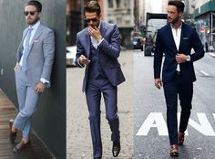
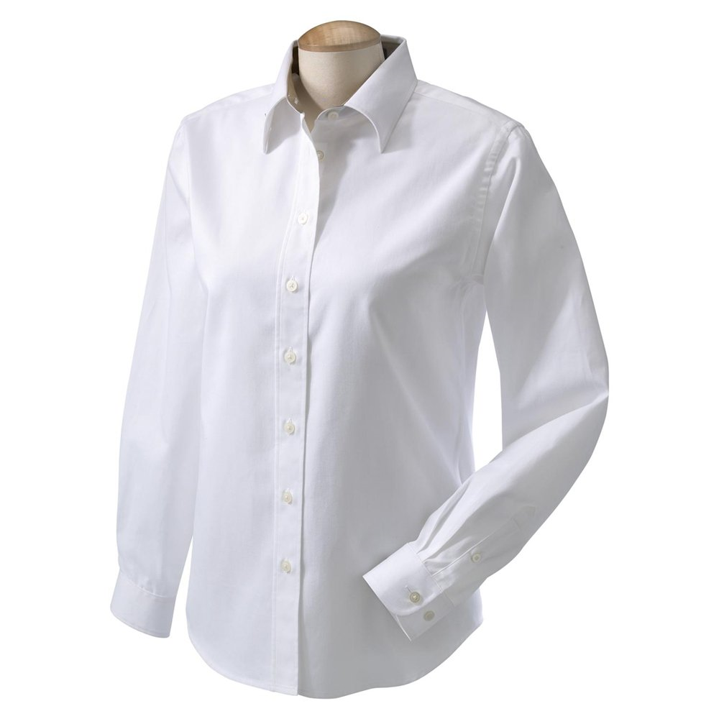
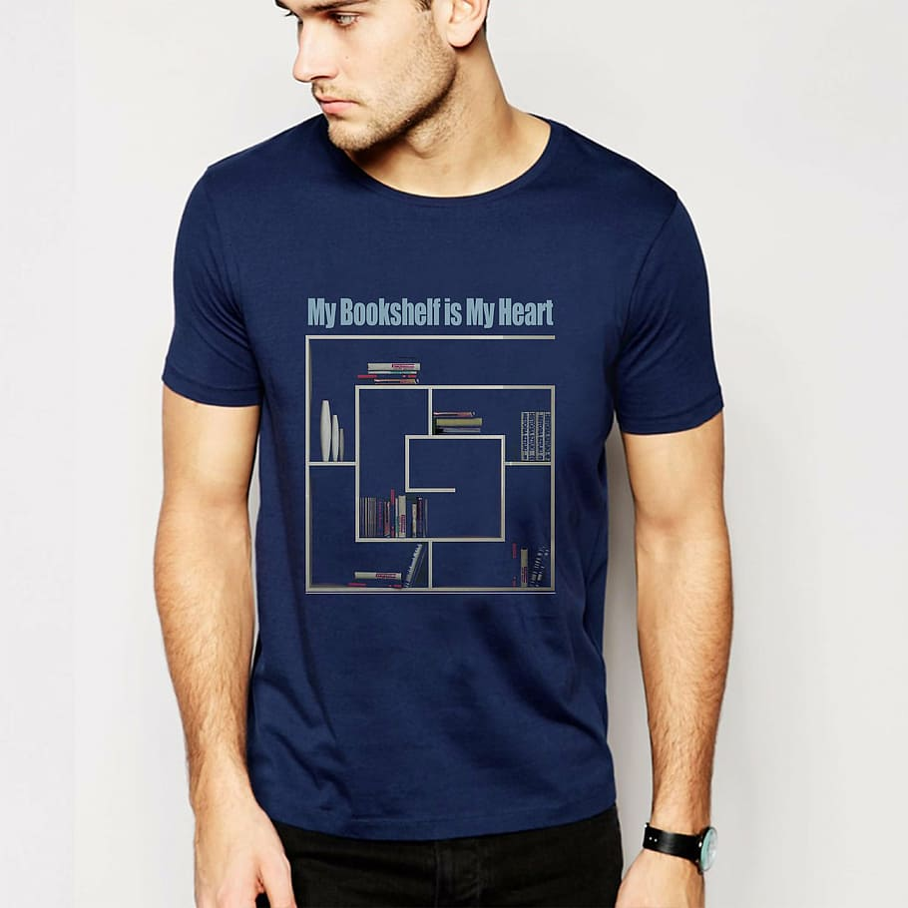
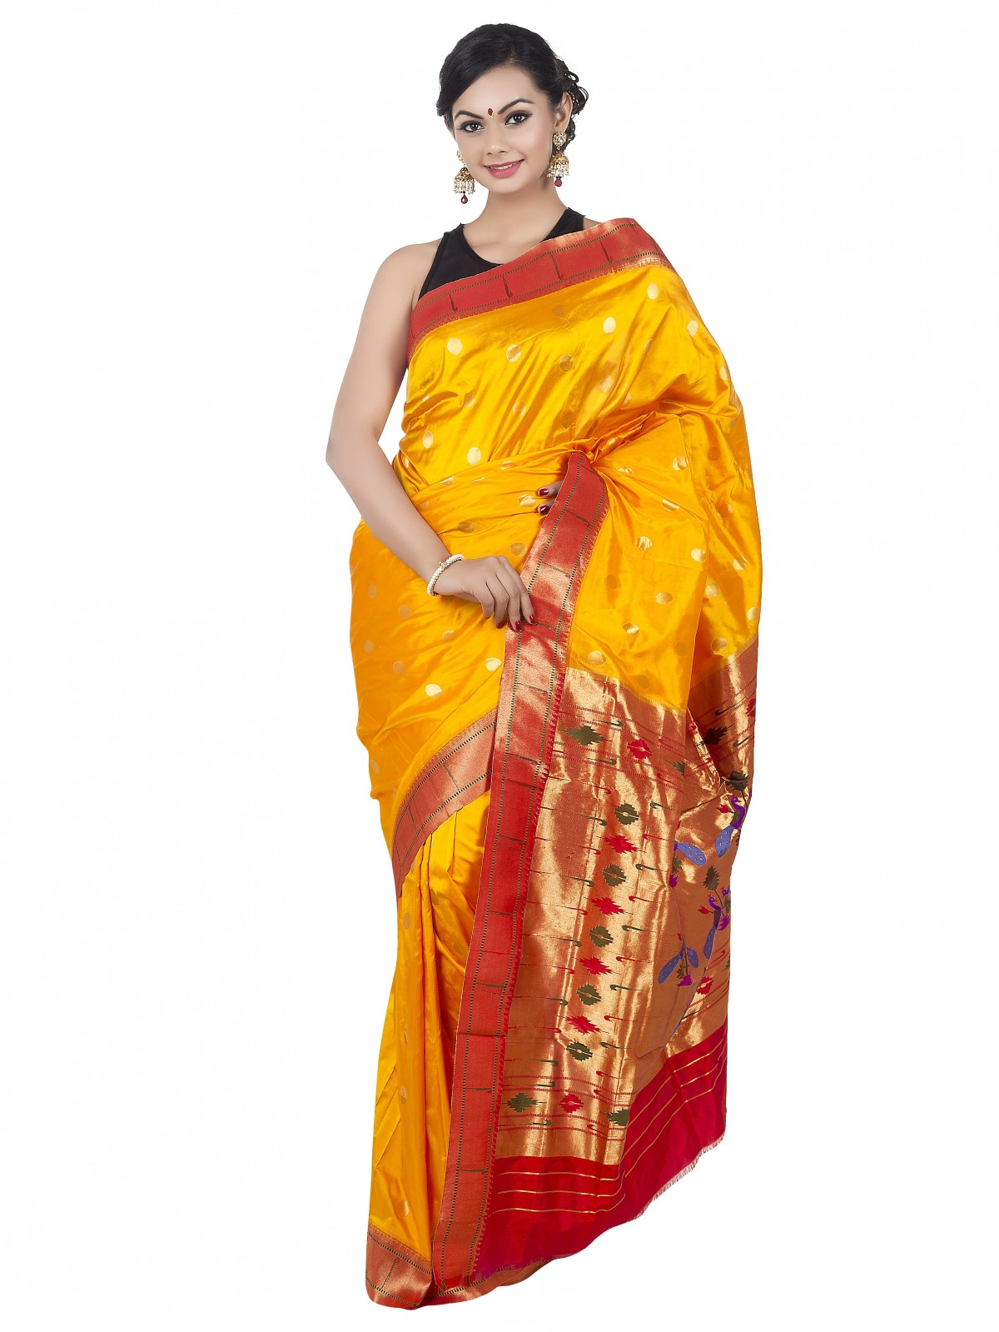

Slide 6
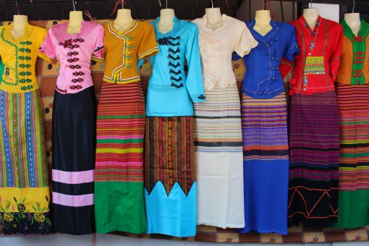
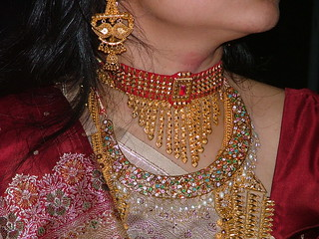
2. Contemporary & Fusion Wear
Western-inspired ethnic dresses
Casual & formal shirts for men
Indo-Western outfits
Modern designer tunics and gowns
3. Fashion Accessories
Handcrafted jewelry
Leather and fabric handbags
Traditional footwear (Nagras, Sandals)
Scarves, stoles, and dupattas

Slide 7
Statistical Analysis of sales and profit of the FBT
Year | Total Sales | Profit
2005 | 25410000 | 15%
2006 | 30400000 | 20%
2007 | 28570000 | 18%
2008 | 32620000 | 21%
2009 | 35987000 | 25%

Slide 8
Yearly Profit of Bangaliana Fashion Ltd.

Slide 9
Thank You

